Slide 1
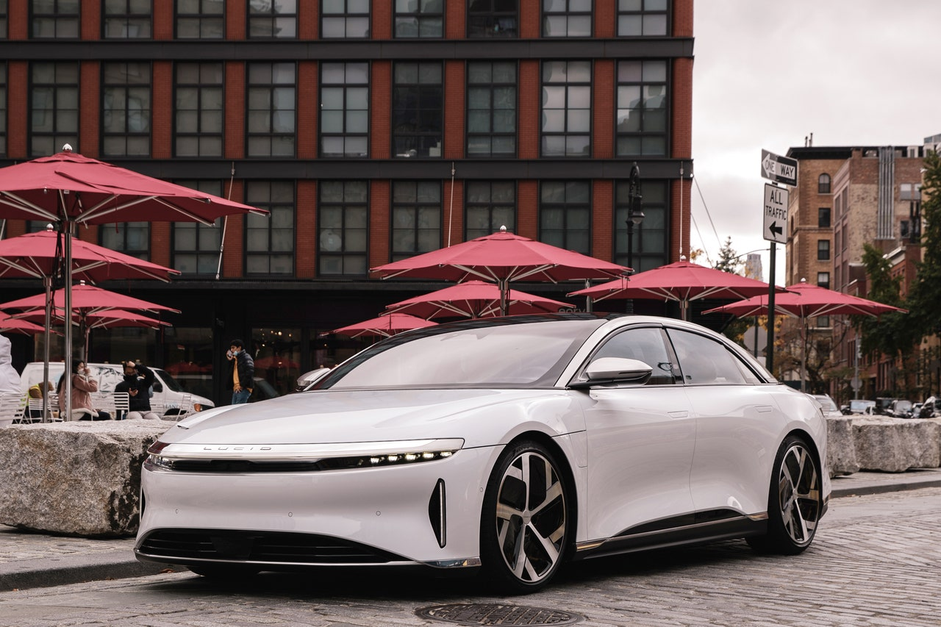
A Project Presentation on “Online Car Rental System”
Under the guidance of
Mr. Yuba raj Devkota
Presented by
Raman Shrestha
Bikram Bishwokarma

Slide 2
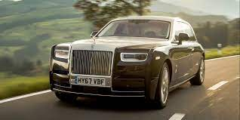
Problem Statement
An existing system works in manually paper work.
The user has to go in the office where user can get the car on rent and book their car.
In the existing system you can not provide feedback of the user to the admin online.

Slide 3

Objectives
It provides features like time efficiency to show car details, user profiles and whatever the customer will give the feedback to the admin.
This system provides tourism and travelling facilities.
It is the most software application for managing online car rental business.

Slide 4
Technology Used:
Front End: HTML, CSS, Java Script.
Back End: PHP, MySQL.

Slide 5
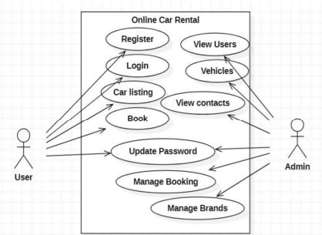
User Case Diagram

Slide 6
User module
Car booking.
View car booking history.
Update his/her profile.
Post testimonials.
View testimonials
Logout

Slide 7
Admin module
Admin can create vehicle brands.
Manage vehicle brands(Edit, Delete).
Manage vehicle (Edit, Delete).
Manage booking of cars.
Manage to contact us Query.
Admin can manage the details of registered users.

Slide 8
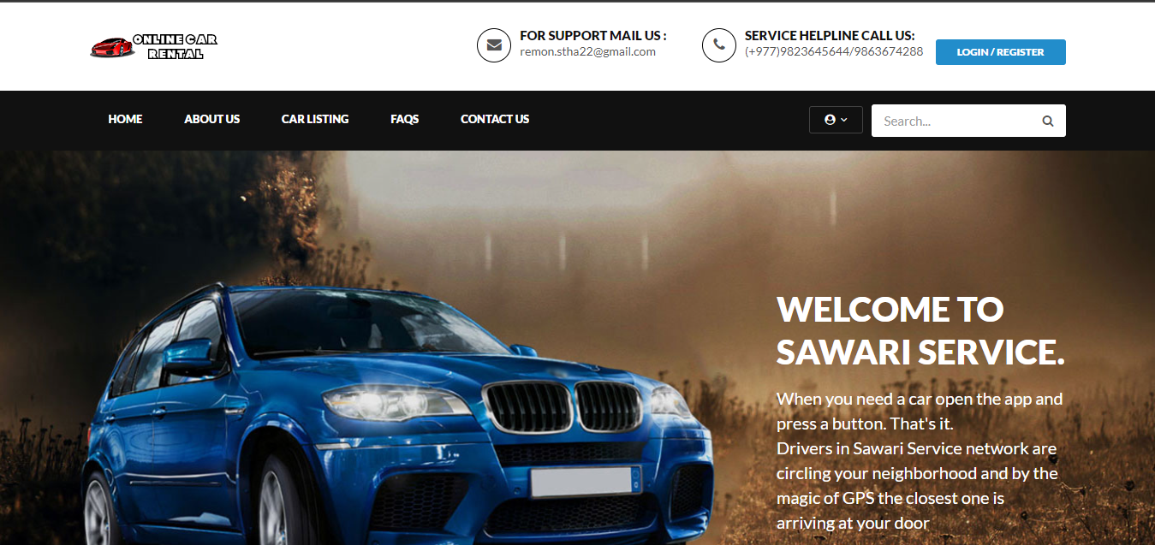
Screenshots of user

Slide 9
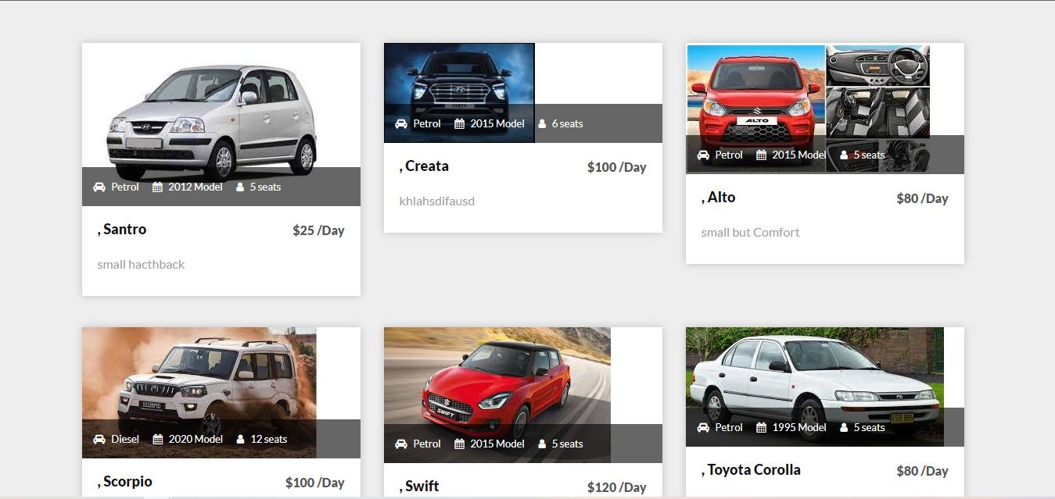
Screenshots of user

Slide 10
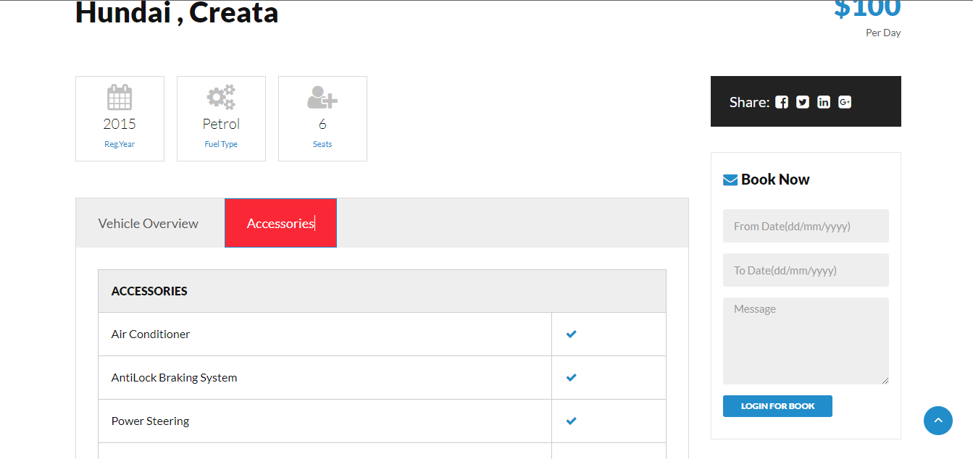
Screenshots of user

Slide 11
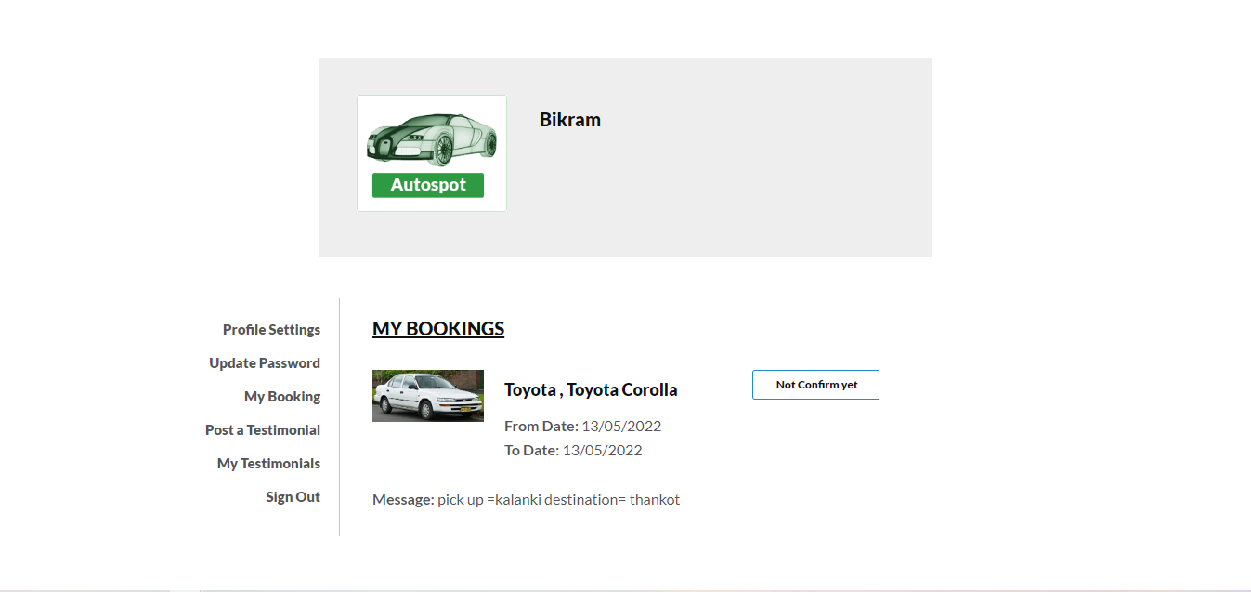
Screenshots of user

Slide 12
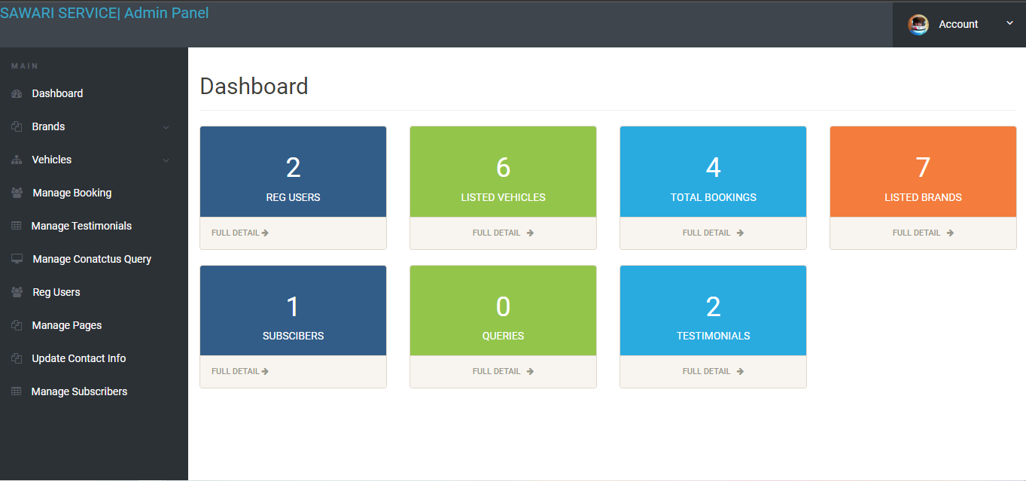
Screenshots of admin

Slide 13
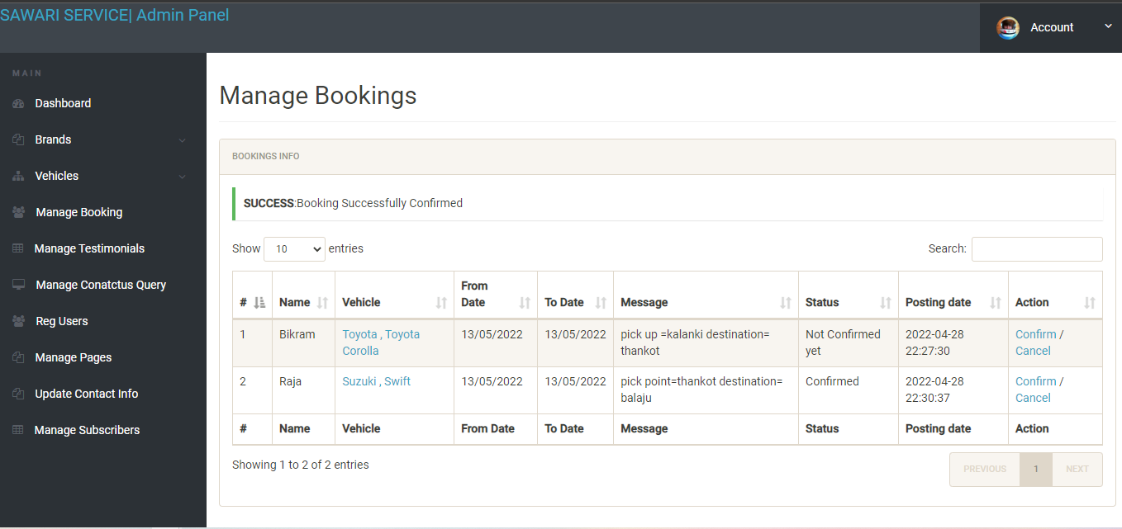
Screenshots of admin

Slide 14
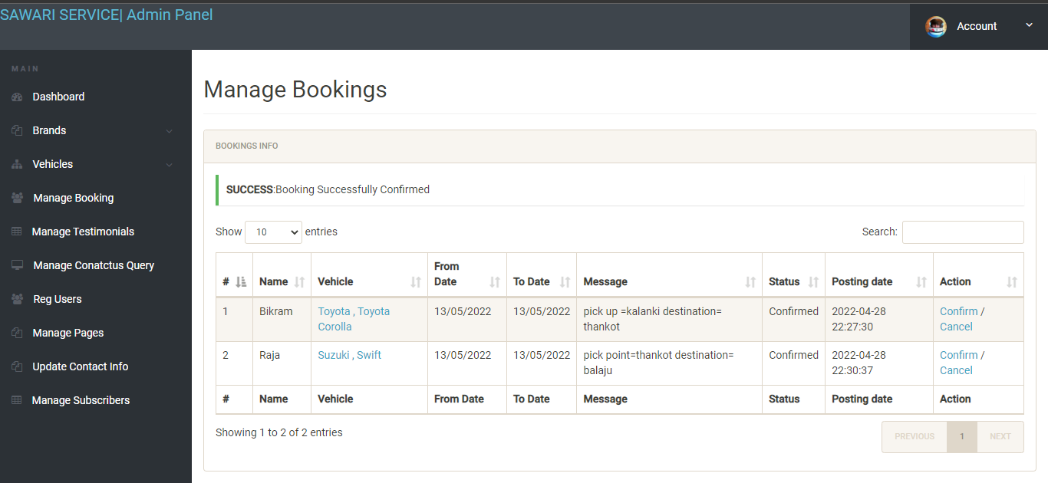
Screenshots of admin

Slide 15
Sawari Service in future
GPS system
Location tracing
Better Comparative to other’s

Slide 16
Conclusion
The solution is to provide car rental with an user-friendly web application that would allow for customers to access and use on a wide range of device like: desktop, laptop, mobile, tablets.
This application is to stay up-to-date by giving administrators ability to change/add/remove any featured vehicles of the site.
This software provides an easy-to-use interface to allow for simple access to rental requests and customer information.

Slide 17
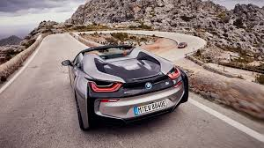
Thank
you

